Slide 1
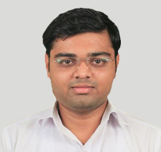
Software Engineering (2104CS402)
Cyclomatic Complexity
Prof. Rajkumar Gondaliya
Computer Engineering Department
rajkumar.gondaliya@darshan.ac.in
+91-9723232741

Slide 2
What is Cyclomatic Complexity
Cyclomatic complexity is a software metric, used to indicate the complexity of a program.
It is calculated by developing a Control Flow Graph of the code.
A control flow graph (CFG) is a directed graph
where
The nodes represent different instructions of a program,
The edges define the sequence of execution of such instructions.

Slide 3
How to Calculate Cyclomatic Complexity
Cyclomatic Complexity can be represented using the below formula:
Cyclomatic complexity = E - N + 2*P
where,
E = number of edges in the flow graph.
N = number of nodes in the flow graph.
P = number of nodes that have exit points
For a single program (or subroutine or method), P is always equal to 1
1
In given graph
E = 6
N = 5
P = 1
2
3
5
4

Slide 4
How to create Control Flow Graph
A program, doesn't always consist of only sequential statements.
There could be branching and looping involved in it as well.
Shows how a CFG would look like if there are sequential, selection and iteration kind of statements in order.
1
1
1
1
2
3
2
2
3
5
2
4
3
4
Sequence
If - else
While
Case

Slide 5
Example of Control Flow Graph
The size of a CFG could be reduced by representing each basic block with a node. To illustrate this, let's consider the following example.
1
Sum = 0;
i = 1;
While (i<=n){
sum += i;
++I;
}
Printf(“%d”,sum)
If(sum>0){
Printf(“Positive”);
}
2
3
4
5
9
6
7
8
10

Slide 6
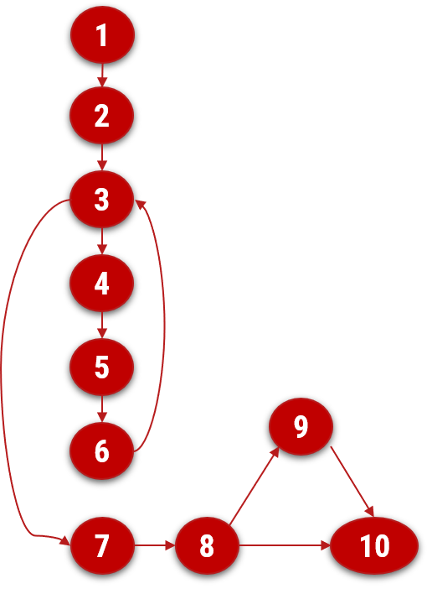
Calculate Cyclomatic Complexity of CFG
Calculate Cyclomatic complexity of given CFG.
Number of Edges in given flow graphs is 11
Number of Node in given flow graphs is 10
Number of nodes that have exit Points is 1
So, Cyclomatic complexity
= E - N + 2*P
= 11 – 10+ 2(1)
= 3

Slide 7
Find Independent Path Using CFG
Create a set of linear independent path of CFG
Path 1: 1 – 2 – 3 – 7 – 8 – 10
Path 2: 1 – 2 – 3 – 7 – 8 – 9 –10
Path 3: 1 – 2 – 3 – 4 – 5 – 6 – 7 – 8 – 10

Slide 8
Software Engineering (2105CS203)
Prof. Rajkumar Gondaliya
Computer Engineering Department
rajkumar.gondaliya@darshan.ac.in
+91-9723232741

